Slide 1

ARTIFICIAL INTELLIGENCE AND ROBOTICS
Topic Name:
Space Robotics
K. K. Wagh Institute Of Engineering Education and Research
Nashik
Class:BE A
Submitted By:
Rutik Rojekar 25 Siddhat Sahare 29
Sohil Sarode 26 Bhushan Bhusare 30
Vidit Bapat 27 Sonali Gangurde 31
Aditya Gade 28 Pranali Khotkar 32
Guided By :
Prof.Kushal Birla
Notes:
1
1

Slide 2
CONTENTS
Introduction
What is Space Robotics?
Space Robot-Challenges in Design and Testing
System Verification and Testing
Structure of Space Robots
Operation
Conclusion
Reference

Slide 3
Introduction
Robot is a system with a mechanical body, using computer as its brain. Integrating the sensors and actuators built into the mechanical body, the motions are realised with the computer software to execute the desired task.
Robots are more flexible in terms of ability to perform new tasks or to carry out complex sequence of motion than other categories of automated manufacturing equipment.

Slide 4
What is Space Robotics?
Development of machines for the space environment.
Usually controlled by humans.

Slide 5
AREAS OF APPLICATION
In orbit positioning and assembly
Operation
Maintenance
Resupply

Slide 6
Scientific Appications under the above categories are
Scientific Experimentation
Assist crew in space station assembly
Space servicing function
Space craft enhancements
Space Tug

Slide 7
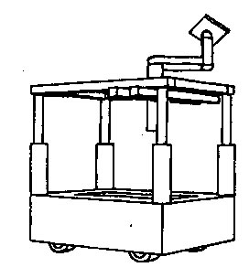
Space Shuttle Tile Rewaterproofing robot
Tessellator-Mobile Manipulator System

Slide 8
Objective of the TWP is
To determine the minimum number of workspaces and their layout.
To determine the optimal route of the workstation movement.

Slide 9
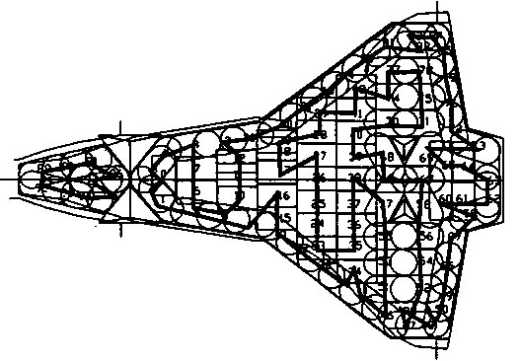
Path of the Tesselator

Slide 10
ROBOTS TO REFUEL SATELLITES
The US department of defense-
Autonomous Space Transporter and Robotic Orbiter (ASTRO)
Expands lifespan of satellites
carry out repair works on faulty satellites

Slide 11
CHALLENGES IN DESIGN AND TESTING
zero gravity - physical action and mechanism performance
The vacuum and thermal conditions of space - material and sensor performance

Slide 12
ZERO ‘g’ EFFECT ON DESIGN
Arm will be light in mass
Manipulator arm -stiffness based
Joint actuators -selected based on dynamic torque (i.e.; based on the acceleration of the arm).
Lack of inertial frame

Slide 13
VACUUM EFFECT AND THERMAL EFFECT
Total mass loss (TML) <1%
Collected volatile condensable matter (CVCM) <0.1%.
Low temperature -embrittlement of the material, weaken adhesive bonding and increase friction in bearings.
Large thermal gradients -distortion in structural elements and jamming of the mechanism

Slide 14
SYSTEM VERIFICATION AND TESTING
The commonly used simulations for zero ‘g’ are
Flat floor test facility
Water immersion
Compensation system

Slide 15
ROBOT PERFORMANCE ASSESSMENT
To identify the main source of error which perturb the accuracy of the arm.
To decide if the arm or the work cell must be calibrated.
To compare the expected improvement in accuracy in calibration.

Slide 16
ROBOT CALIBRATION
Calibration must be done on ground
Calibration is performed in five steps:
Modeling
Measurement,
Identification
Model implementation
Verification
Performance Evaluation

Slide 17
STRUCTURE OF SPACE ROBOTS
6 degrees of freedom (DOF).
The main subsystems in the development of the manipulator arm are
Joints
Arm
Wrist
Gripper

Slide 18
JOINTS
Two types of joints are
Roll joint
Pitch joint
Each joint consists of
Electro optical angular encoders
Pancake type DC torque motors
Harmonic gear
Electromagnetically actuated friction brakes

Slide 19
OPERATION
SPACE SHUTTLE ROBOT ARM
Use
Survey the outside of the Space Shuttle
Transport an EVA crew member at the end of the arm
Satellite deployment and retrieval
Construction of International Space Station

Slide 20
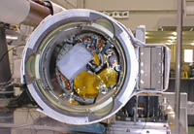
Shuttle robot arm observed from the deck

Slide 21
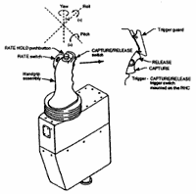
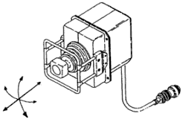
ROBOT ARM OPERATION MODE
THC RHC

Slide 22
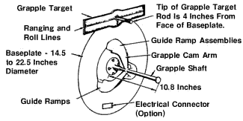
HOW SPACE SHUTTLE ROBOT ARM GRASPS OBJECT?
End effector and grapple fixture

Slide 23
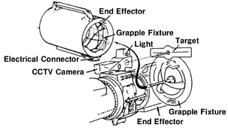
Robot arm’s payload acquiring sequence

Slide 24
FREE FLYING SPACE ROBOTS
In a free flying space robot a robot arm is attached to the satellite base
The satellite may start rotating in an uncontrollable way.
The antenna communication link may be interrupted

Slide 25
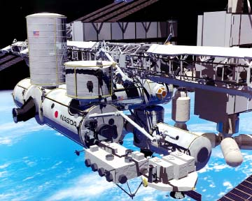
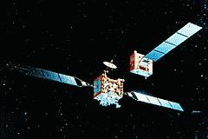
Free flying space robots

Slide 26
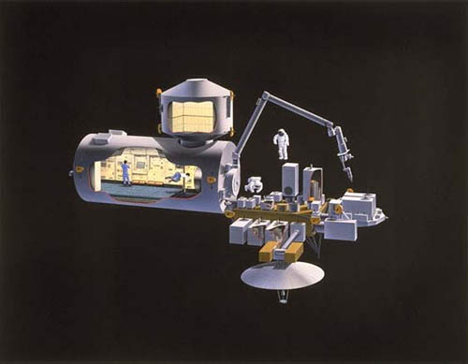
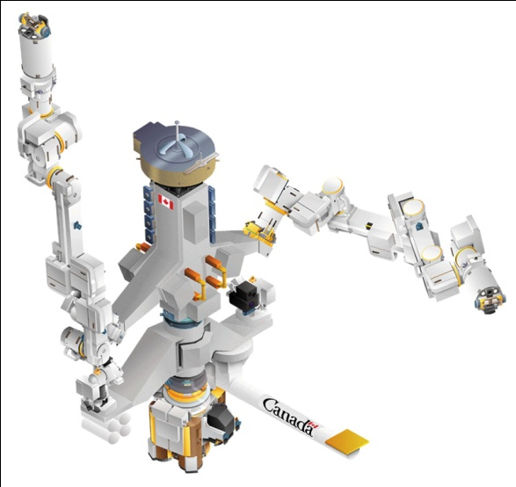
SPACE STATION MOUNTED ROBOTS
JEMRMS SPDM

Slide 27
SPACE ROBOT TELEOPERATION
Develop a completely autonomous robot
Teleoperation technologies for the robots with high levels of autonomy become very important
Teleoperation of space robots from the ground in the future space missions.

Slide 28
CONCLUSION
In the future, robotics will makes it possible for billions of people to have lives of leisure instead of the current preoccupation with material needs.
There are hundreds of millions who are now fascinated by space but do not have the means to explore it.
For them space robotics will throw open the door to explore and experience the universe.

Slide 29
References
www.google.com
www.wikipedia.com
www.studymafia.org

Slide 30
Thanks

